Slide 1
Lead Scoring Case Study
Group Members
A Ajay Kumar
Aditya Sil
Aesha Agrawal

Slide 2
Problem solving methodology

Slide 3
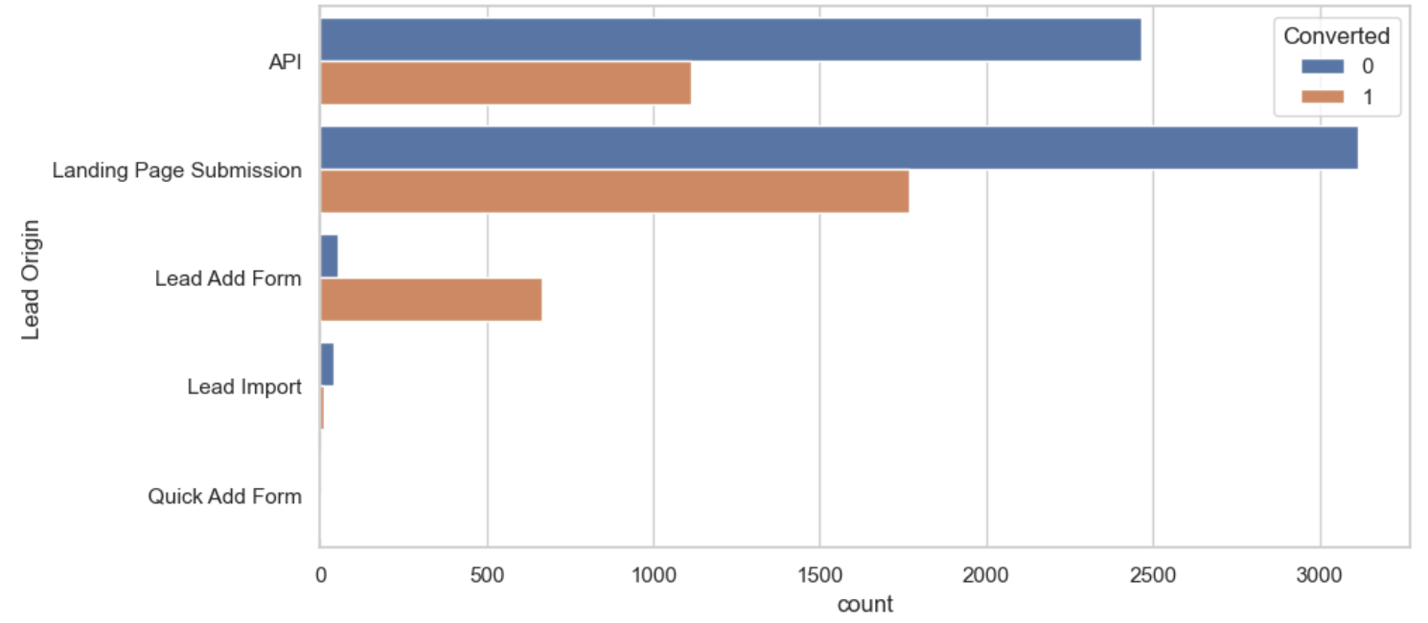
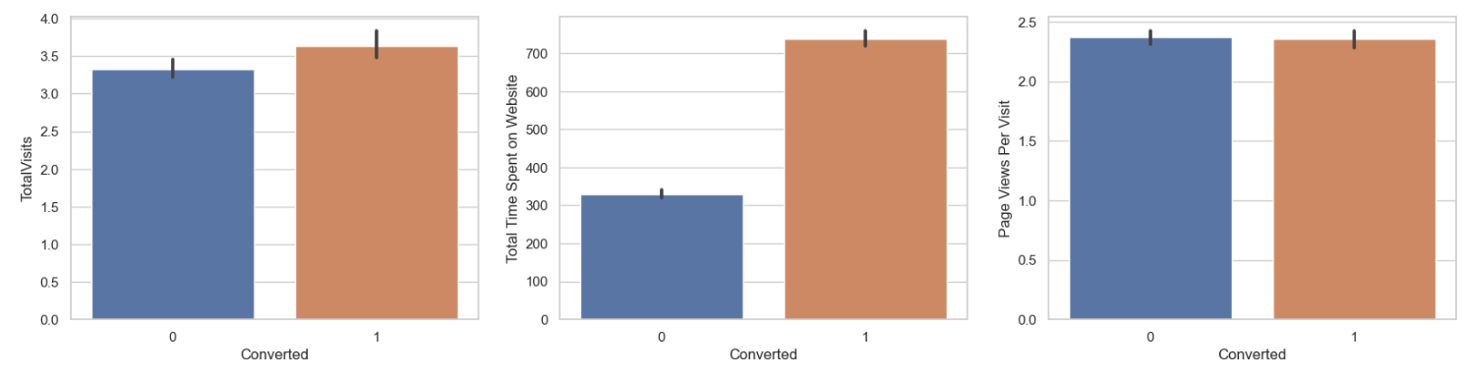
Exploratory Data Analysis
In lead origin maximum conversion happened for
landing page submission
Conversion rates were high for Total Visits, Total Time Spent on Website and Page Views Per Visit

Slide 4
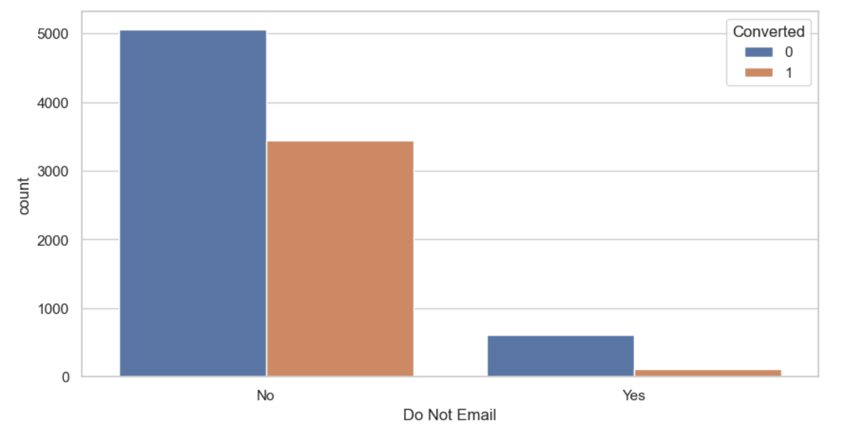
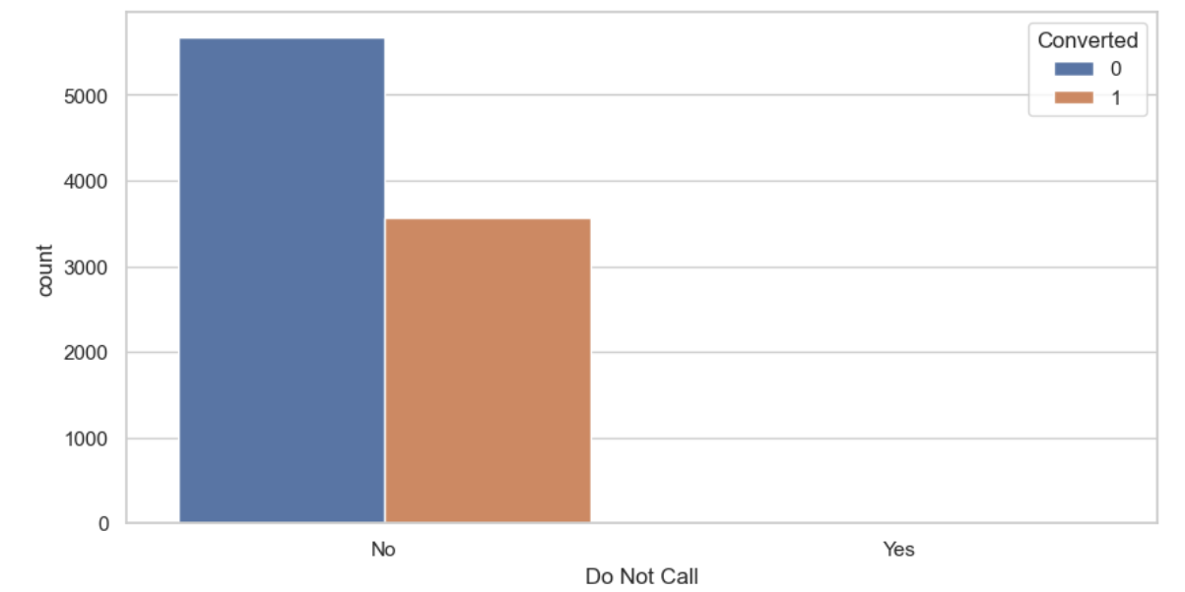
Majority of Conversions happen for Emails sent and calls made

Slide 5
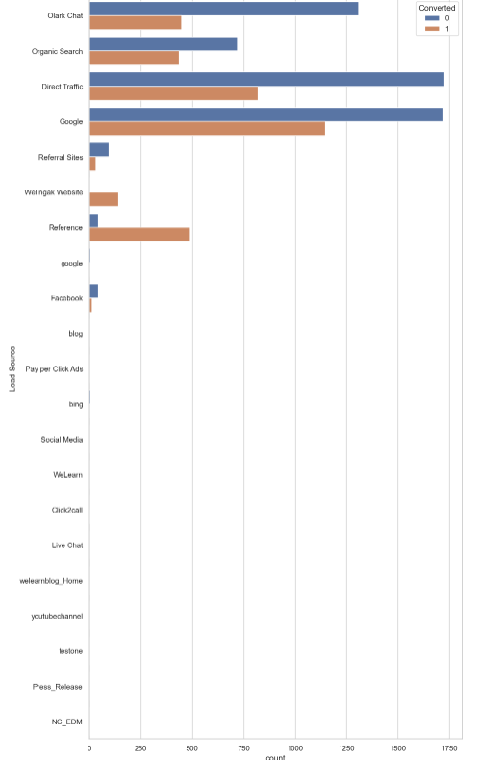
In lead source maximum conversion is from google

Slide 6
DATA CONVERSION
Numerical Variables are Normalized
Dummy Variables are created for object type variables
Total Rows for Analysis: 9240
Total Columns for Analysis: 28

Slide 7
VARIABLES INPACTING CONVERSION RATE
Do Not Email
Total Visits
Total Time Spent On Website
Lead Origin –Lead Page Submission
Lead Origin –Lead Add Form
Lead Source -Olark Chat
Last Source –Welingak Website
Last Activity –Not Sure
Last Activity –Olark Chat Conversation
Last Activity –SMS Sent
Current Occupation –No Information
Current Occupation –Working Professional
Last Notable Activity –Had a Phone Conversation
Last Notable Activity –Unreachable
Last Activity –Email Bounced

Slide 8
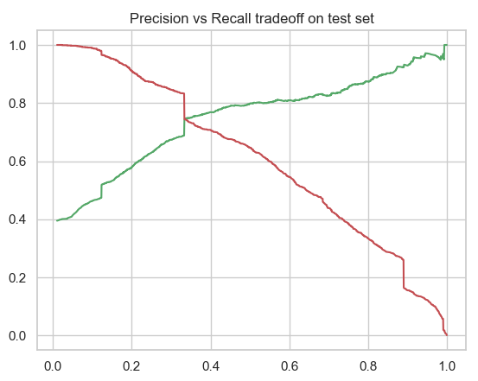
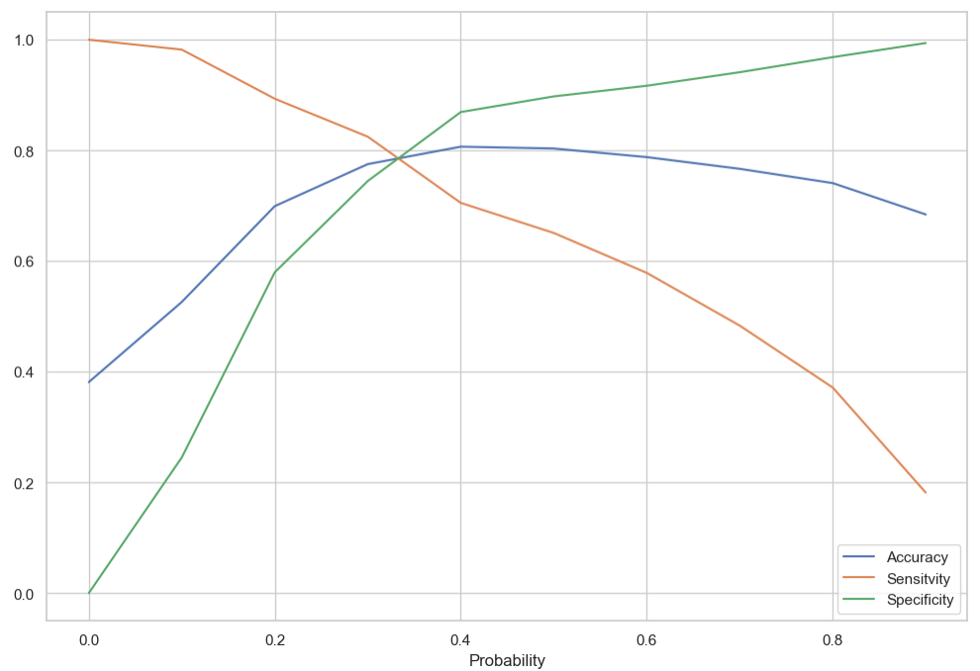
Model Evaluation
Plotting Accuracy, Sensitivity and Specificity
Predication vs recall tradeoff on train set

Slide 9
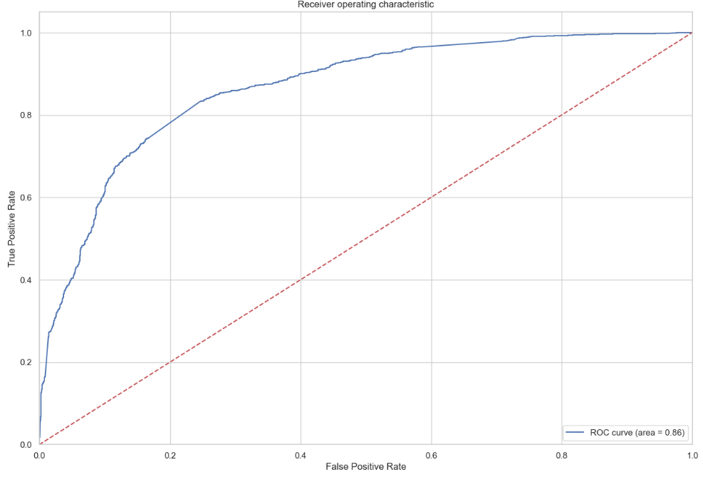
Prediction on the test dataset
ROC curve

Slide 10
Metrics Comparison between Train data set and Test data set
Train Data Set metrics:
Sensitivity: 82.48
Specificity: 74.46
Precision: 66.56
Recall: 82.48
Accuracy: 77.52
Test Data Set metrics:
Sensitivity: 84.57
Specificity: 73.23
Precision: 67.35
Recall: 84.57
Accuracy: 77.71

Slide 11
Based on the analysis
The model's performance metrics such as sensitivity, specificity, accuracy, precision, and recall scores from the test set are considered accurate and indicative of a well-performing model. The model exhibits a higher recall score than precision, which is favorable in this context. From a business perspective, the model shows promise in adapting to the company's future requirements, suggesting its stability. The identified important features, including Lead Origin_Lead Add Form, Total Time Spent on Website, and What is your current occupation_Working Professional, are significant contributors to the probability of lead conversion. These findings provide valuable insights into the model's effectiveness and the factors influencing lead conversion.

